Slide 1

ENVIRONMENTAL
VISIT MR. RAGHUTE’S ECO-FRIENDLY HOME
STUDIES
Government Polytecnic, Nagpur
PRESENTED BY-
1) Lavanya Vaidya
2) Vaidehi Upankar
3) Krushna Thakare
Mentor: Parth Bhongade

Slide 2
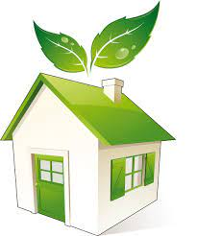
INTRODUCTION
As per our topic, First at all we visit to this location.
Then Mr. Raghute sir gives us a brief information about their home. Afterwords, we try to find out about the detail of material which used to construct and New Ideas.
Important Points-
What is
Eco-friendly
home?
Information about Eco-friendly Homes.
2. Detail About Material.
3. Some New Ideas Related to It.
4. Advantages and Disadvantages.

Slide 3
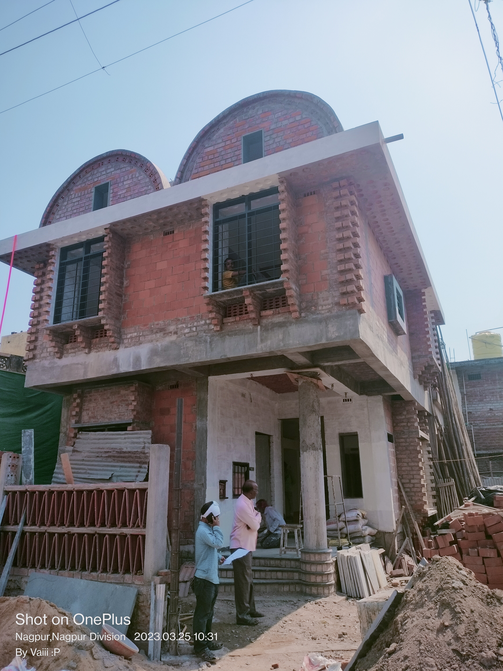
ECO-FRIENDLY HOME IN ACTUAL IS AS FOLLOWS,
Real Facts which we understood due to this visit, are as follows:
It’s not mandatory to have 100% Eco-friendly home.
Common Misunderstanding among people is-
Eco-friendly home means,
Each and every material use to
construct such home is natural.
But this is Wrong
THE HOUSE WE VISITED

Slide 4
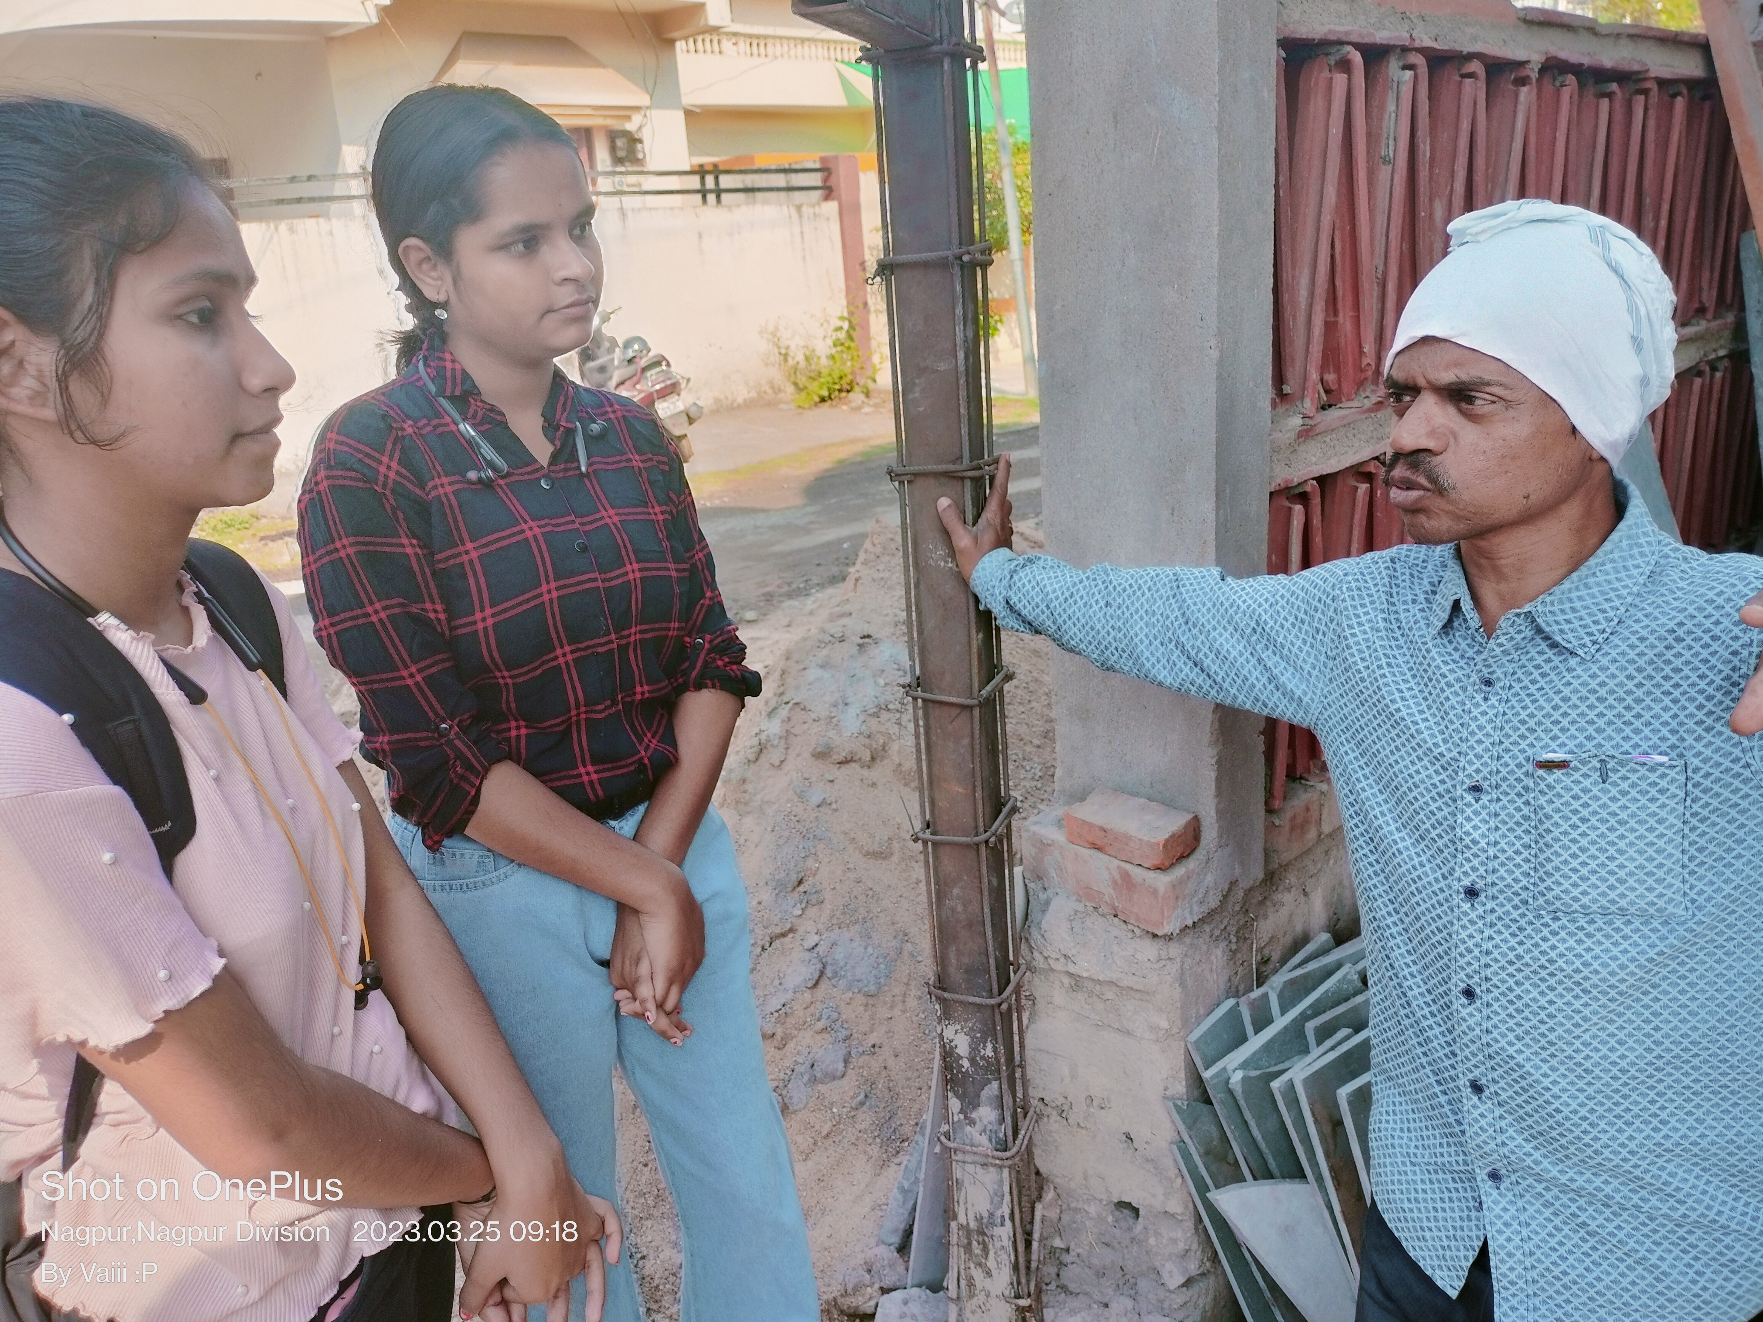
IMPORTANT POINTS ABOUT ECO-FRIENDLY HOME
Some Real life facts which we collect from the Real life experience of Mr. Shyam Raghute, that all are important for construing such type of home.
Such home is Not Made from 100% Natural material.
Material utilization is Important.
3. In less place getting lots of benefits.
4. Sustainability is the next of step Eco-friendly
home.
5. Changes are also Important for this home.
This are also Important points for constructing such type of home.
MEET WITH MR. RAGHUTE & HOME.

Slide 5
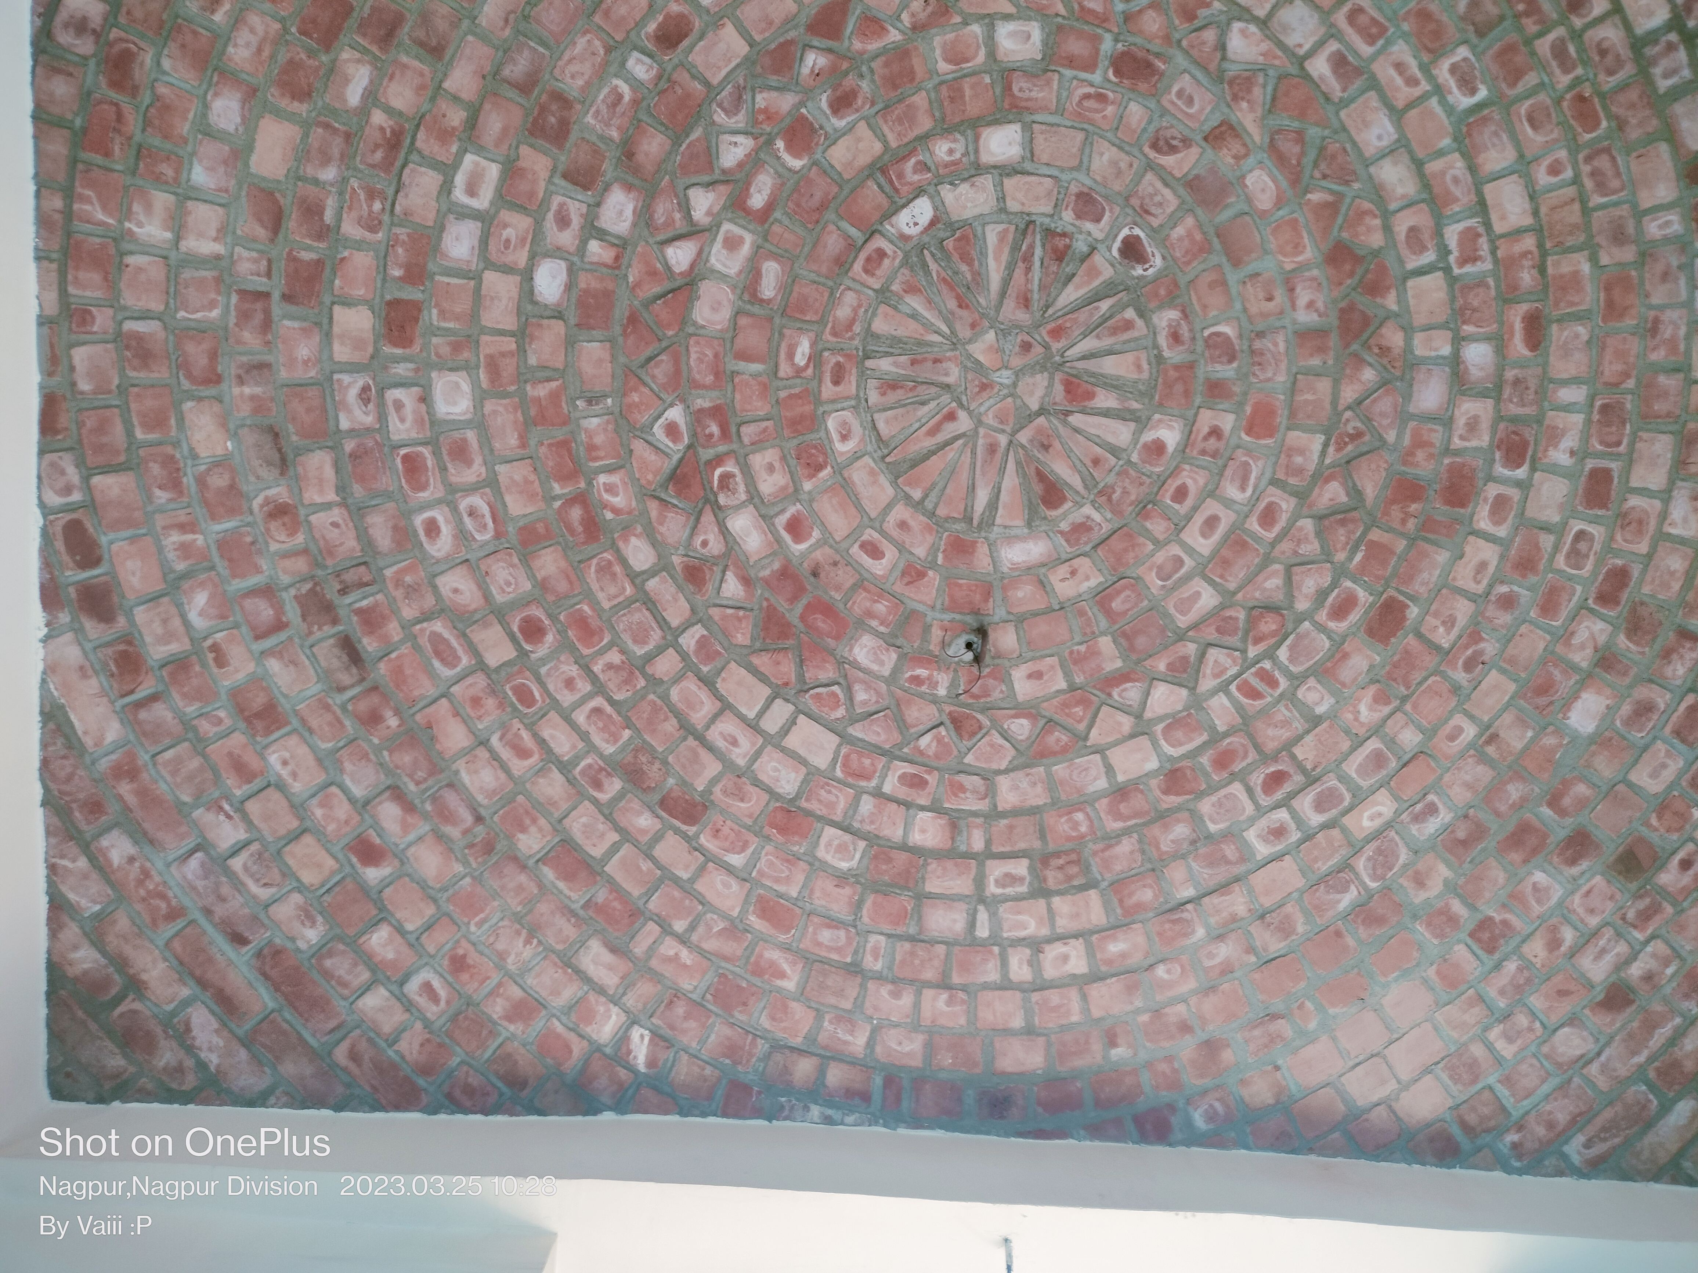
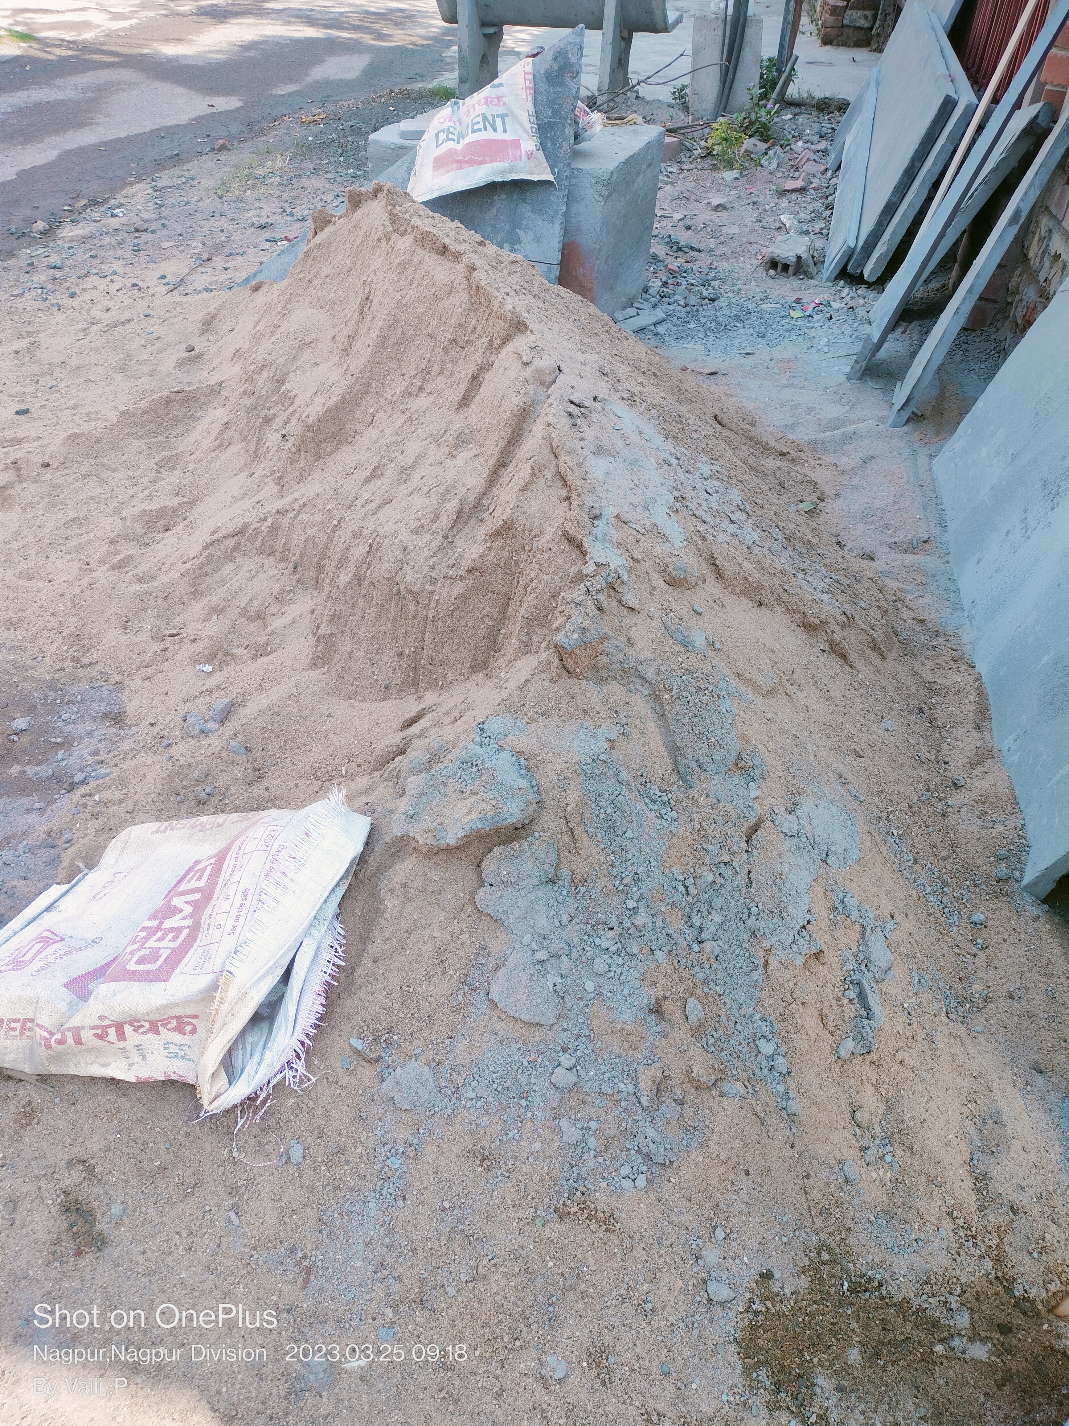
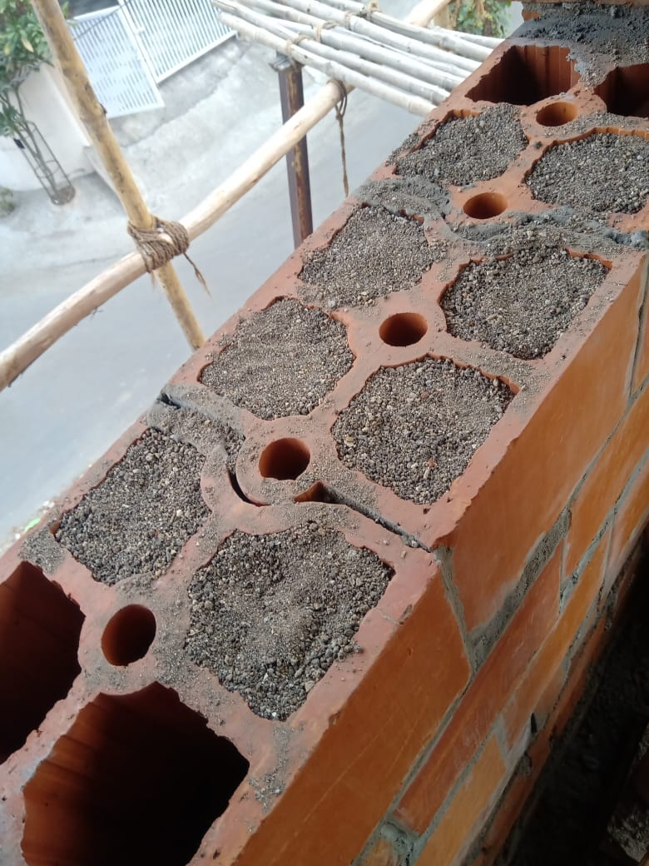
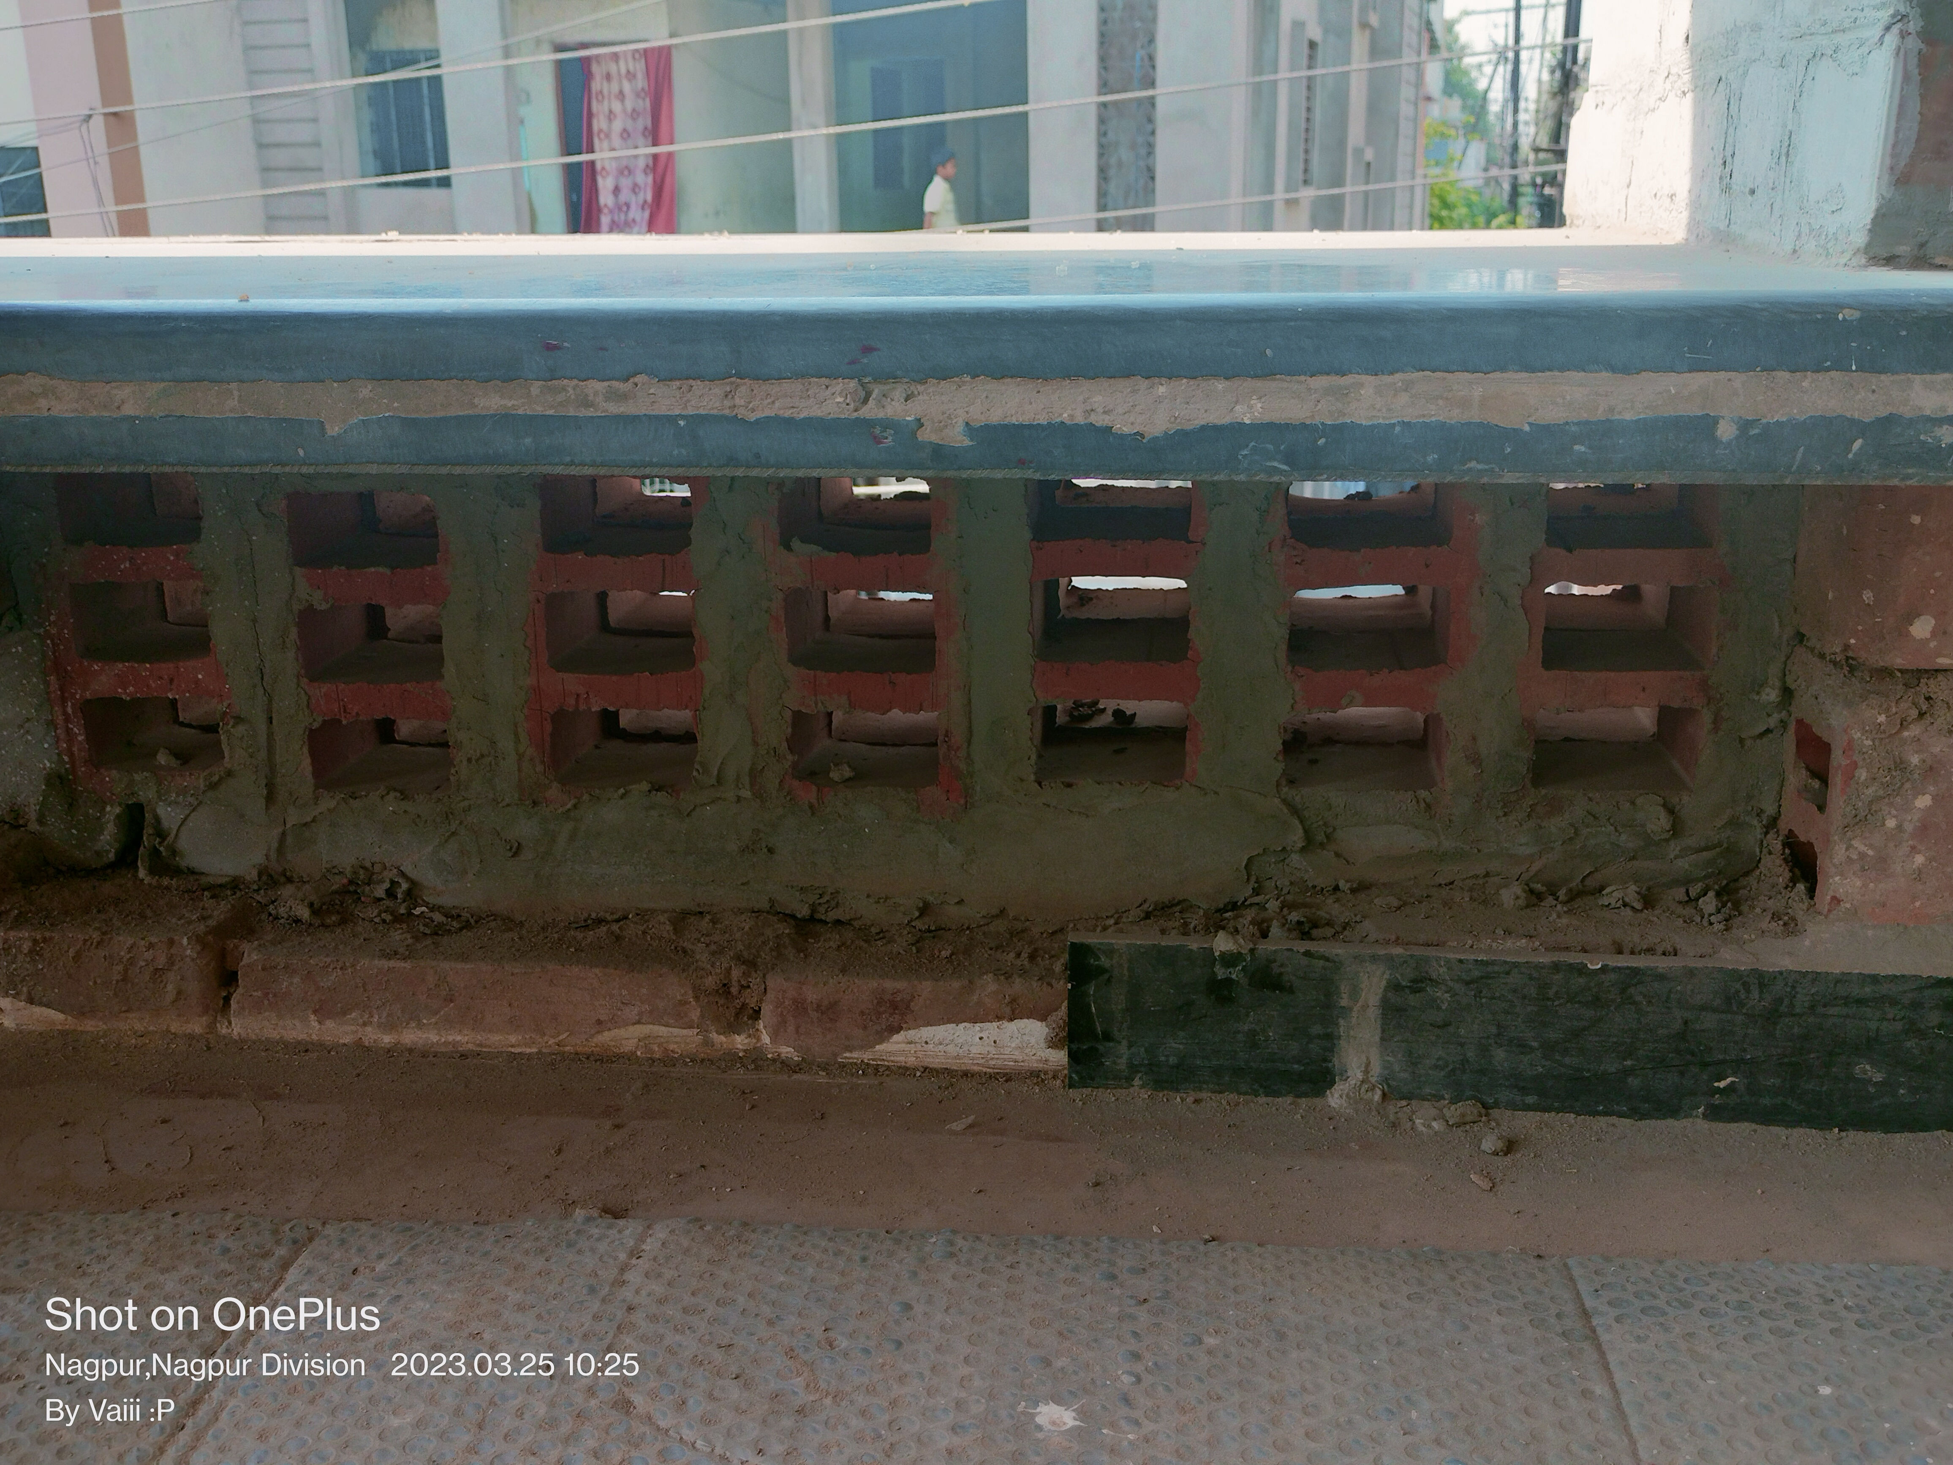
MATERIAL AND MORE
Natural sand is the best material for such type of home,
Brick roof required only 3 days for construction.
Wall ventilation takes cold air inside and throw out the hot air.
This brick made from natural clay with strong terracotta clay stones.
BRICK ROOF
natural sand
BLOCK BRICKS
(TERACoTTA)
brick VENTILATION

Slide 6
PROS AND CONS ABOUT MATERIAL AND MORE
ELEVATED WATER TANK
Provides a constant water supply, Backup water soure & improve water quality.
High Maintainance & cost and vulnerable to contamination.
BLOCK BRICKS(TERRACOTTA)
Easy to use, Isulating properties, Asthetics and Durable.
Heavy, Limited Design & colour options, Porous and costly.
BRICK VENTILATION
Moisture & Thermal control, Energy efficient.
Insects-pest entries, Noise transmission.
BRICK ROOFING
Weather resistance, Low maintainance and Energy efficient.
Limited design options, High cost and Hard to Installation.

Slide 7
ADVANTAGES-
DISADVANTAGES-
They are designed to have minimal impact on environment.
It can have positive social impact.
Reduction in waste and More efficient recycling.
Improvements in Indoor air quality.
They also have features like natural lighting, Insulation and temperature control systems, which provide a comfortable living
1.Some people might not like the
designes of green buildings.
2.Experience green construction
workers may be rare.
3.Avaibility of green construction
materials.
4. Eco-friendly homes has higher
upfront costs.
5. They may not be as readily available
as traditional homes.

Slide 8
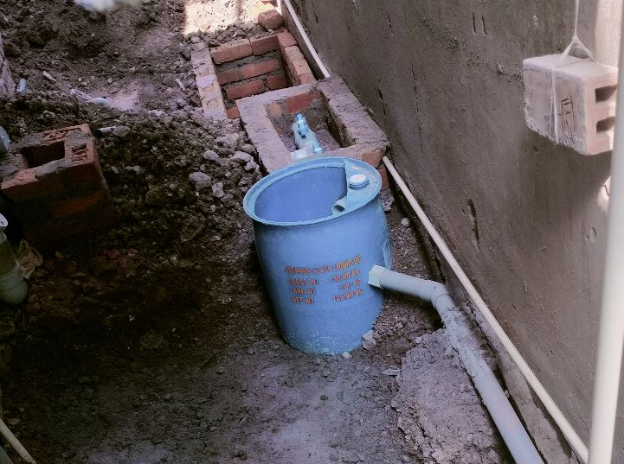
NEW IDEAS
Prevents contamination of water
resource.
Further treatment can turn the waste
into fertilizer
which.
3. It is an innovative method to
decompose waste in an eco-
friendly and economical manner.
Benefits-
1. GREEN BIO TOILET
Green toilet. (Excreta)
Bio-Digestion process.
Treated water storage.
Agriculture and gardening
Recycle water for Toilet flush.
WORK IN PROGRESS, ABOUT CONSTRUCTION OF GREEN BIO-TOILET.

Slide 9
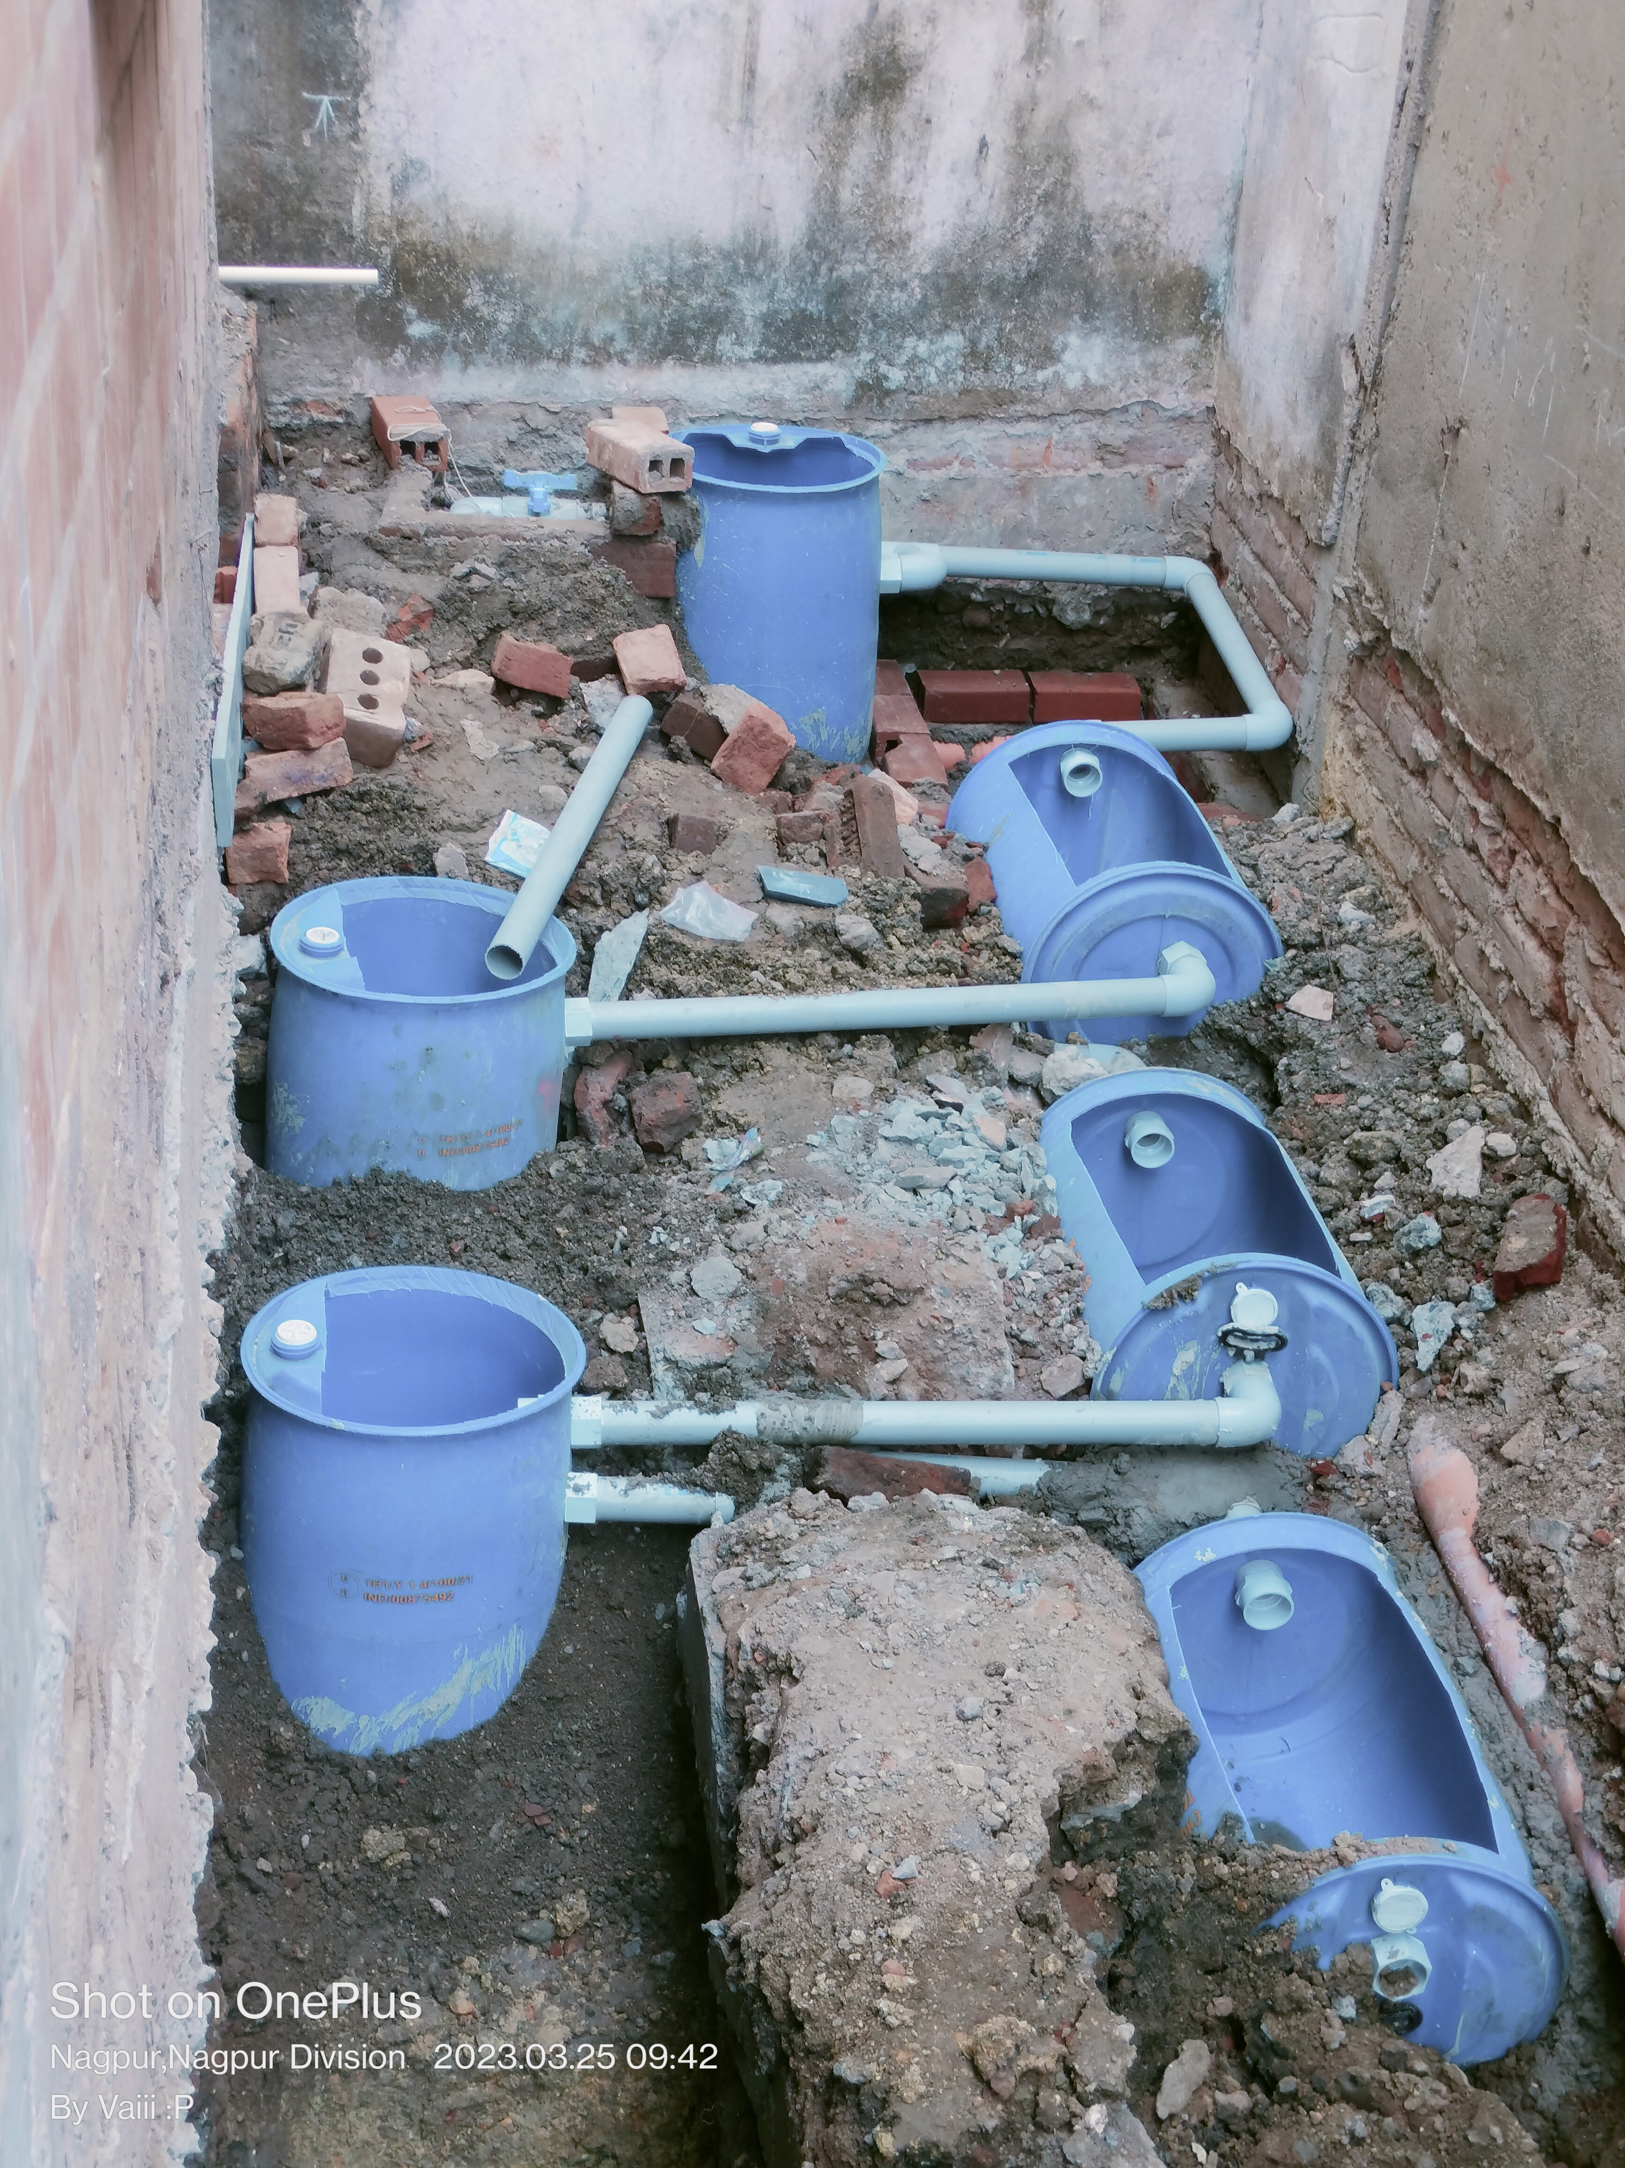
2. WATER RECYCLING SYSTEM
IMPLEMENTATION
IN INDIA AND INFORMATION.
One of the key advantages of recycling water is to protect
water resources by reducing water pollution
discharges and the
need for water to be removed from natural habits.
1. According to Indian Green Building Council(IGBC), India has achieved 7.17 billion sq ft ‘Green Building Footprint’.
2. It’s says that, there are almost 6000 green projects over 5.77 lakh acres of large development projects in country.
3. It helping to achieve the 75% of the green building footprint target, two years before the actual target date.
This includes agricultural and landscape irrigation,
toilet flushing, and of course, drinking.

Slide 10
CONCLUSION :-
Eco-friendly homes are designed to use lesss energy and resources than traditional homes do.
They also use recycled material whenever possible and minimise waste.
Roughly about Rs. 1750/sq ft. About 21 lakhs for every floor, with built with complete finishes.
They can help save the environment.

Slide 11
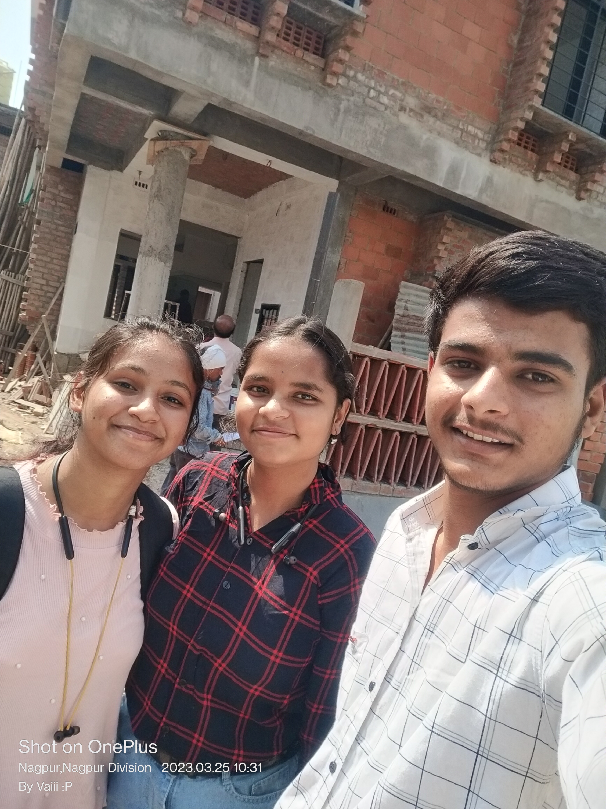
THANK YOU!!

